Slide 1
Gradient Descent

Slide 2
Motivation

Slide 3
Function Example

Slide 5
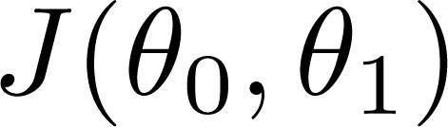
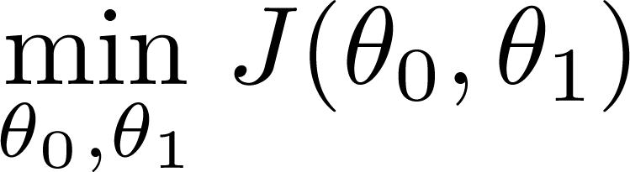
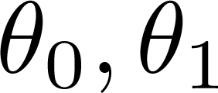
Have some function
Want
Outline:
Start with some
Keep changing to reduce until we hopefully end up at a minimum

Slide 6
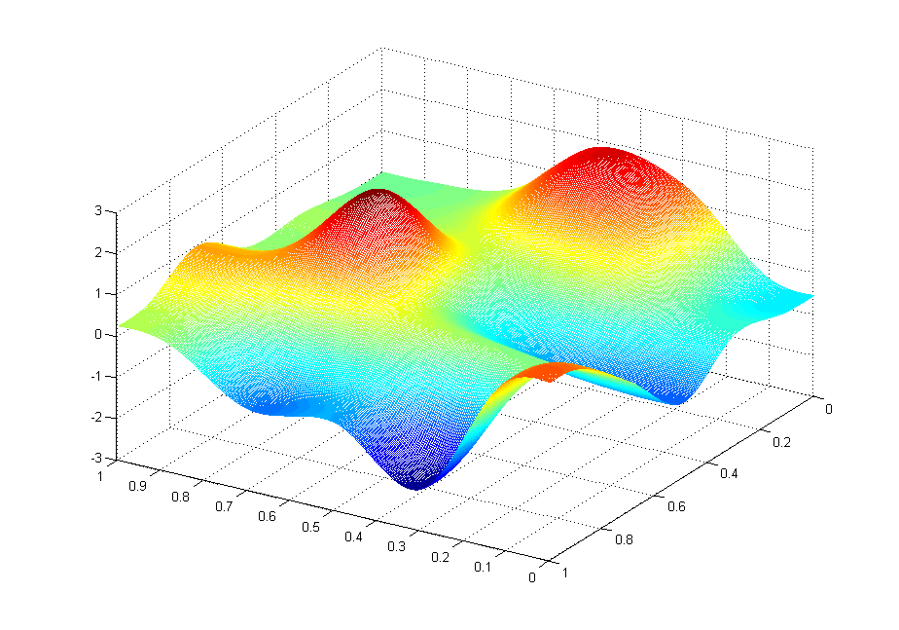
J(θ₀,θ₁)
θ₁
θ₀

Slide 7
J(θ₀,θ₁)
θ₁
θ₀

Slide 8
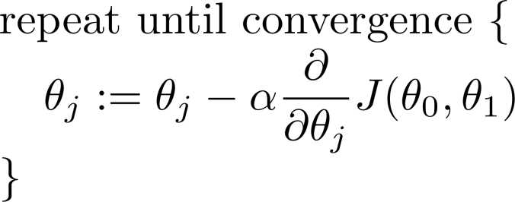
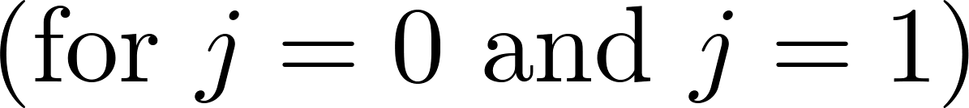
Gradient descent algorithm

Slide 9
Gradient Descent Intuition
Linear regression with one variable

Slide 10
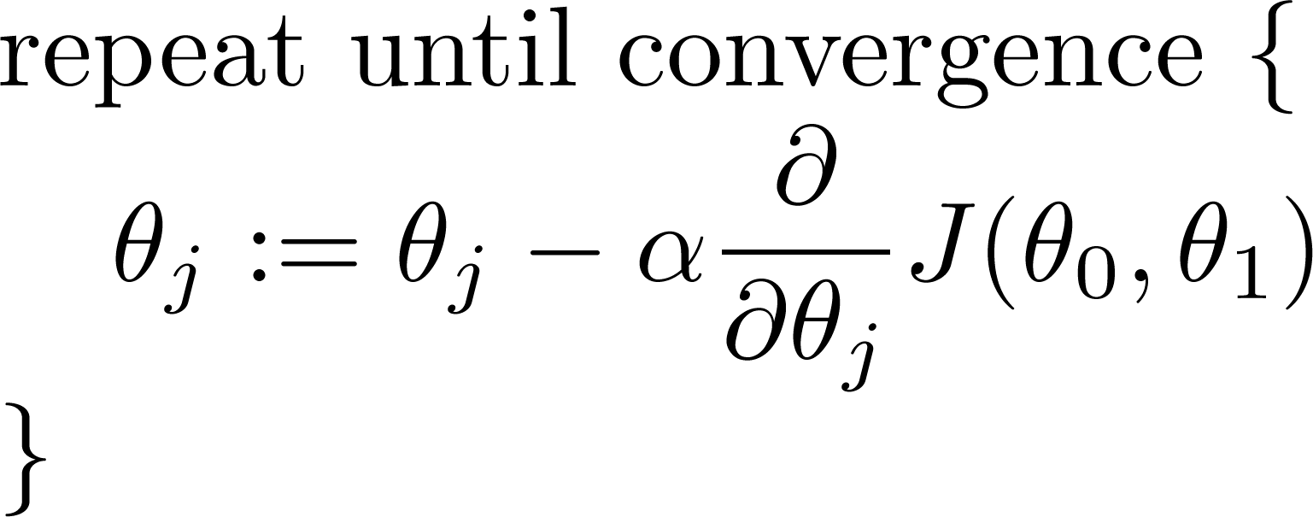
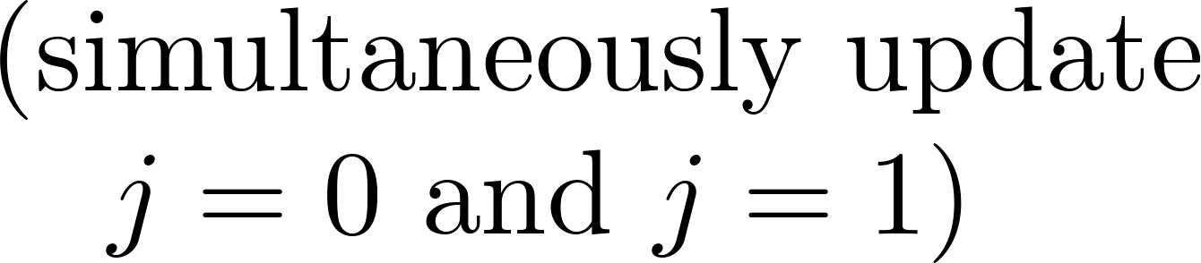
Gradient descent algorithm

Slide 11


Gradient Descent
Gradient Descent Algorithm:
Pick an initial point $x_{0}$
Iterate until convergence
$$x_{t+1}=x_{t}−γ_{t}∇f(x_{t})$$
where $γ_{t}$ is the $t^{th}$ step size (sometimes called learning rate)
Possible Stopping Criteria: iterate until $\left\|∇f(x_{t})\right\|≤ε$ for some $ε>0$
How small should $ε$ be?

Slide 12
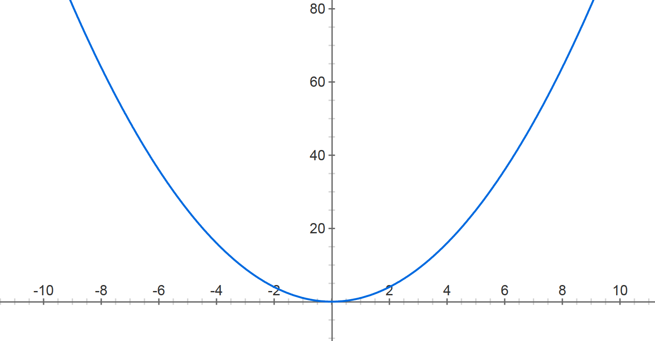



Gradient Descent
$$f\left(x\right)=x^{2}$$
Step size: $.8$
$$x^{(0)}=−4$$

Slide 13


Gradient Descent
$$f\left(x\right)=x^{2}$$
Step size: $.8$
$$x^{(0)}=−4$$
$$x^{(1)}=−4− .8⋅2⋅(−4)$$

Slide 14

Gradient Descent
$$f\left(x\right)=x^{2}$$
Step size: $.8$
$$x^{(0)}=−4$$
$$x^{(1)}=2.4$$

Slide 15



Gradient Descent
$$f\left(x\right)=x^{2}$$
Step size: $.8$
$$x^{(0)}=−4$$
$$x^{(1)}=2.4$$
$$x^{(2)}=2.4− .8⋅2⋅2.4$$
$$x^{(1)}=0.4$$

Slide 16

Gradient Descent
$$f\left(x\right)=x^{2}$$
Step size: $.8$
$$x^{(0)}=−4$$
$$x^{(1)}=2.4$$
$$x^{(2)}=−1.44$$

Slide 17





Gradient Descent
$$f\left(x\right)=x^{2}$$
Step size: $.8$
$$x^{(0)}=−4$$
$$x^{(1)}=2.4$$
$x^{(2)}=−$1.44
$$x^{(3)}=.864$$
$$x^{(4)}=−0.5184$$
$$x^{(5)}=0.31104$$
$$x^{(30)}=−8.84296e−07$$

Slide 19
How the learning goes wrong
If the learning rate is big, the weights slosh to and fro across the ravine.
If the learning rate is too big, this oscillation diverges.
What we would like to achieve:
Move quickly in directions with small but consistent gradients.
Move slowly in directions with big but inconsistent gradients.
E
w

Slide 20
Be careful about turning down the learning rate
Turning down the learning rate reduces the random fluctuations in the error due to the different gradients on different mini-batches.
So we get a quick win.
But then we get slower learning.
Don’t turn down the learning rate too soon!
reduce learning rate
error
epoch

Slide 21
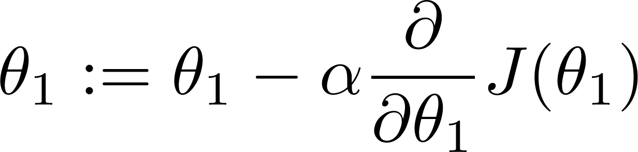

What happens If α is too small?
Gradient descent can be slow.
What if α is too large?
Gradient descent can overshoot the minimum. It may fail to converge, or even diverge.

Slide 22

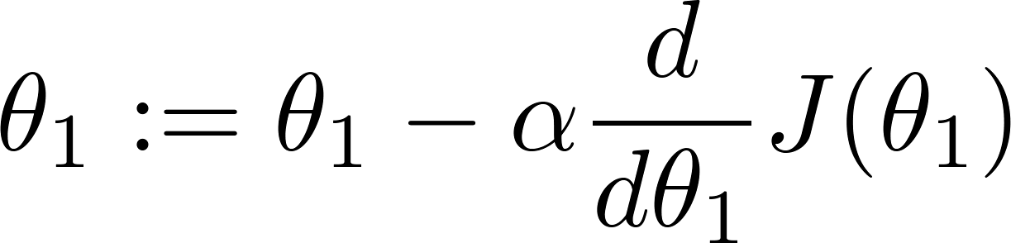
at local optima
Current value of

Slide 23

Gradient descent can converge to a local minimum, even with the learning rate α fixed.
As we approach a local minimum, gradient descent will automatically take smaller steps. So, no need to decrease α over time.

Slide 25
Gradient Descent for Linear Regression
Linear regression with one variable

Slide 26
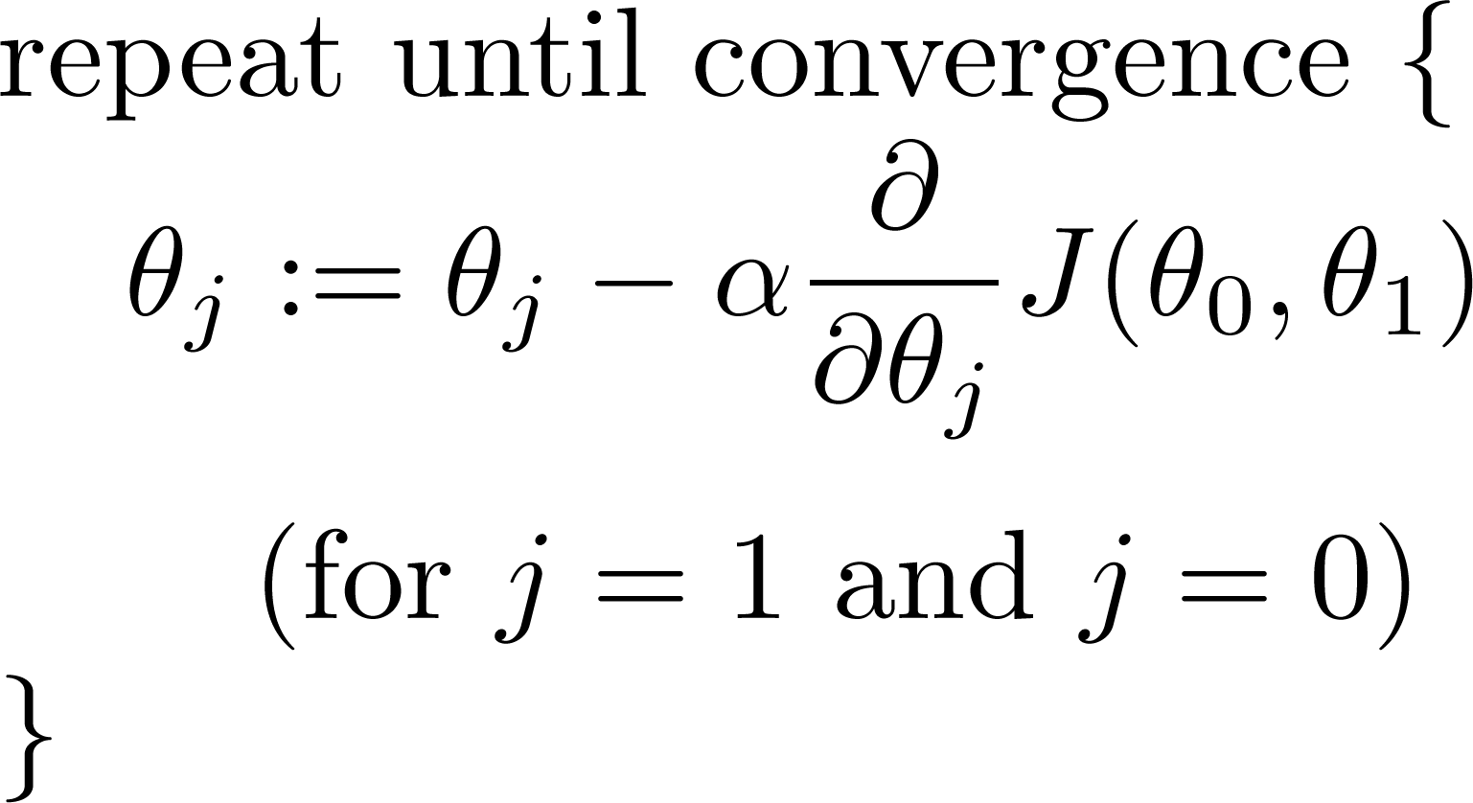
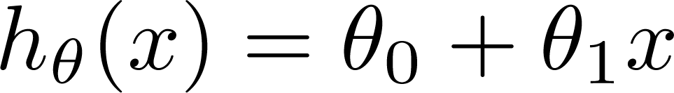
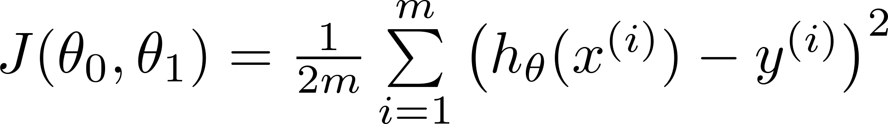
Gradient descent algorithm
Linear Regression Model

Slide 27
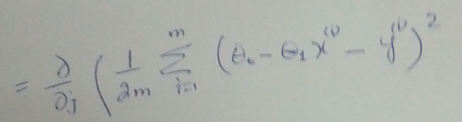
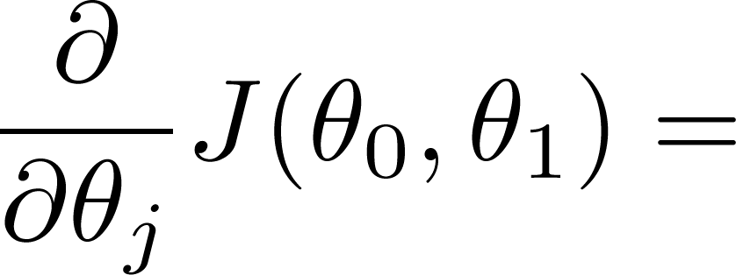
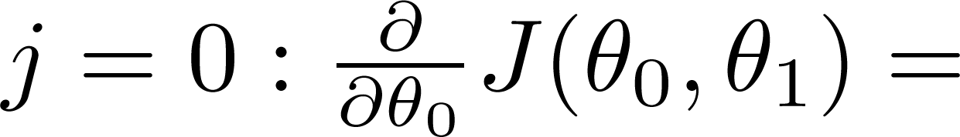
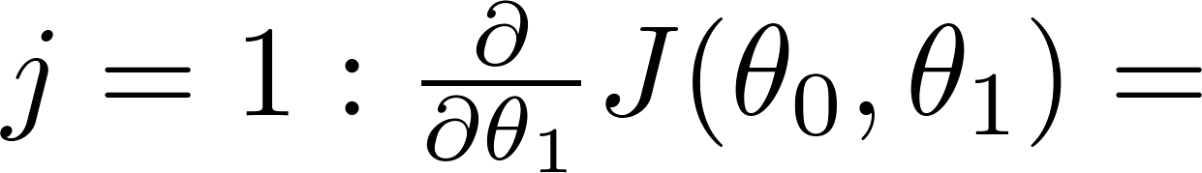

Slide 28
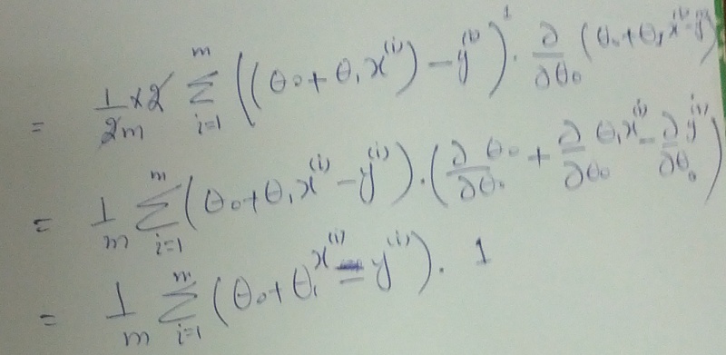

Slide 29
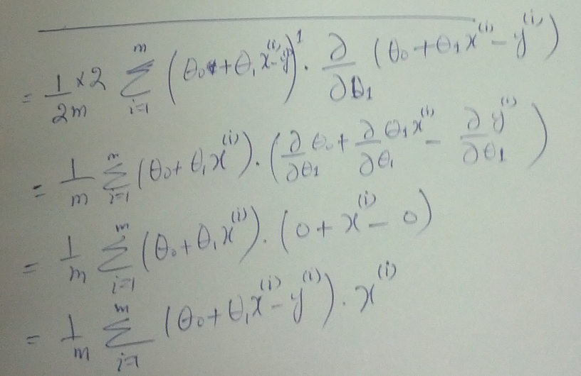

Slide 30
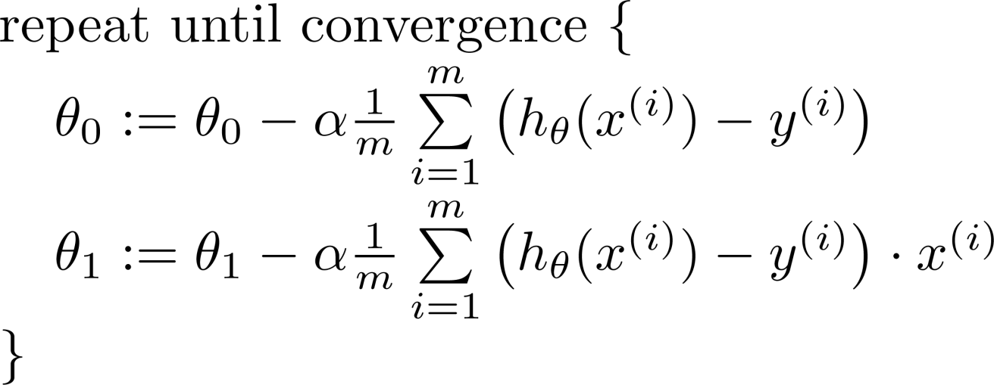

Gradient descent algorithm
update
and
simultaneously

Slide 31
J(θ₀,θ₁)
θ₁
θ₀

Slide 32
J(θ₀,θ₁)
θ₁
θ₀

Slide 33
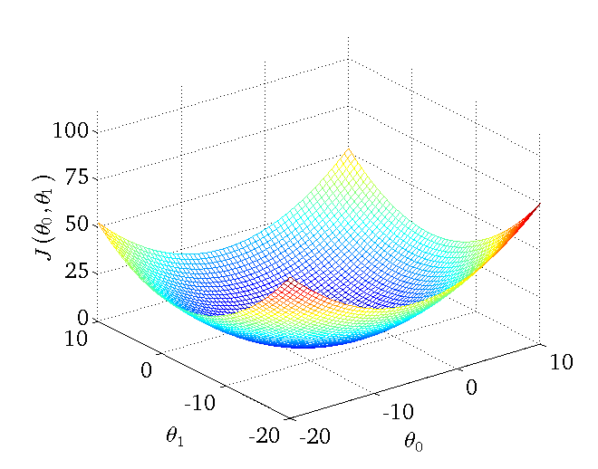

Slide 34



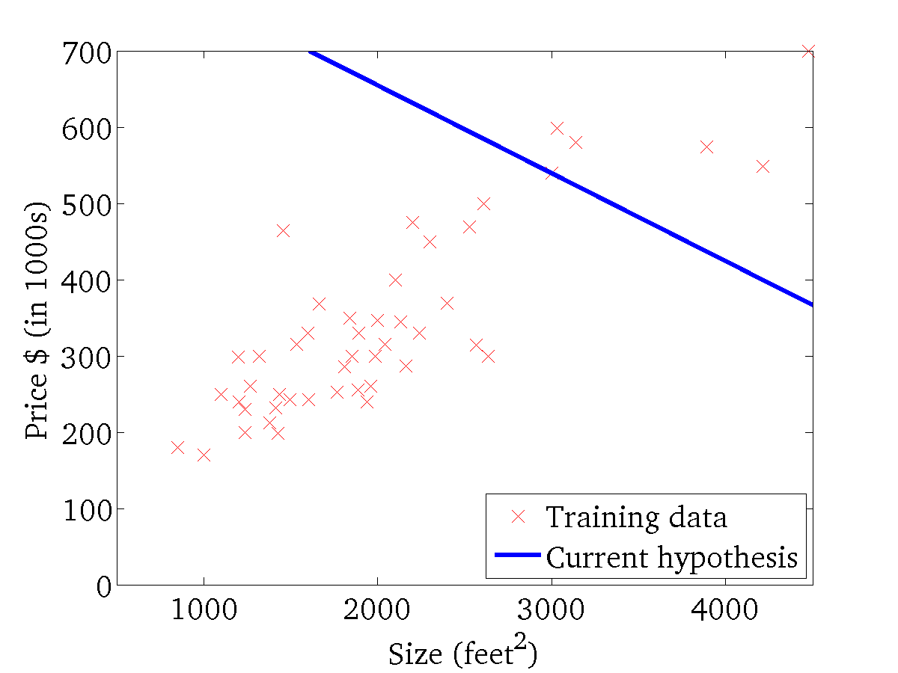
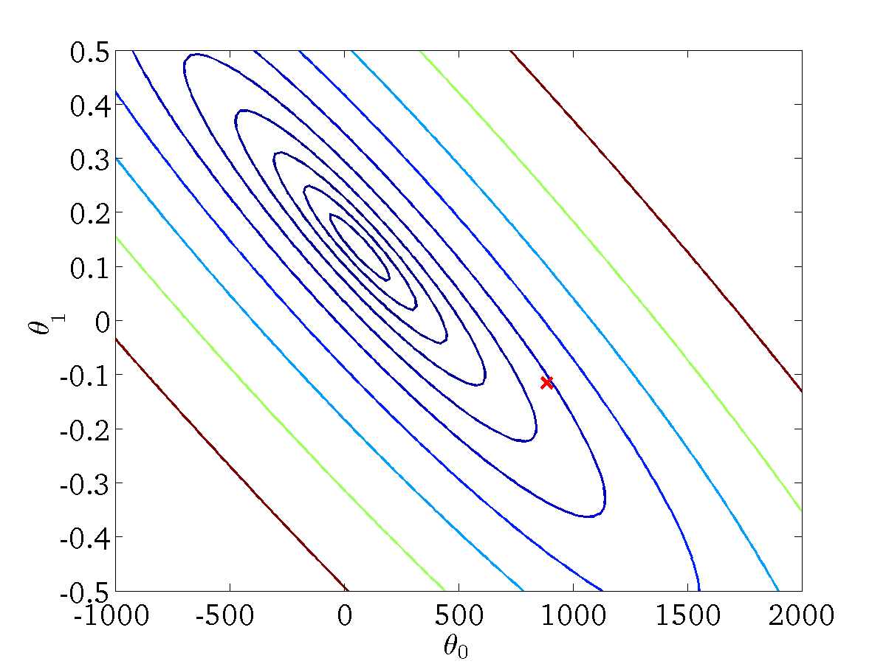
(for fixed , this is a function of x)
(function of the parameters )

Slide 35
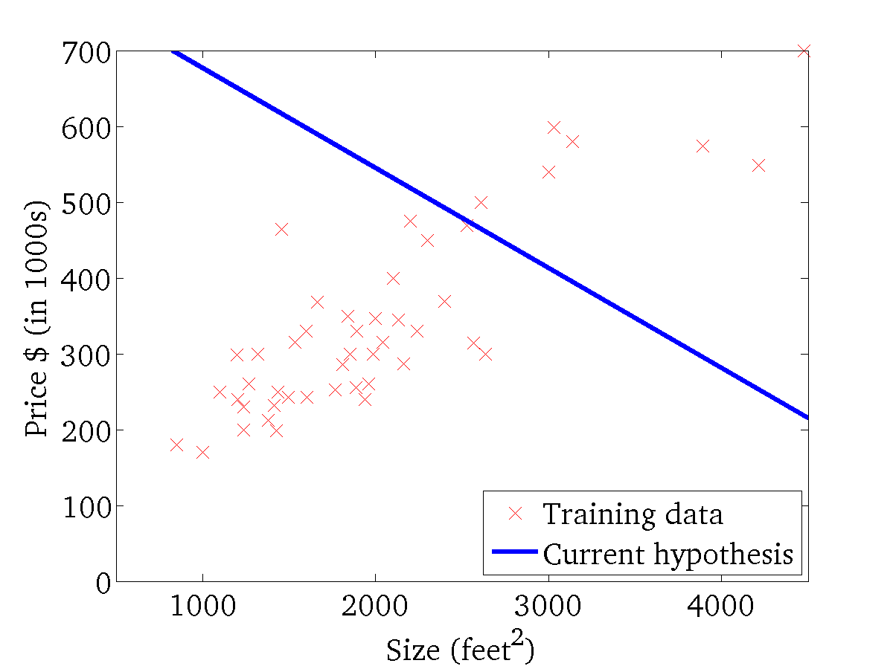

(for fixed , this is a function of x)
(function of the parameters )

Slide 36
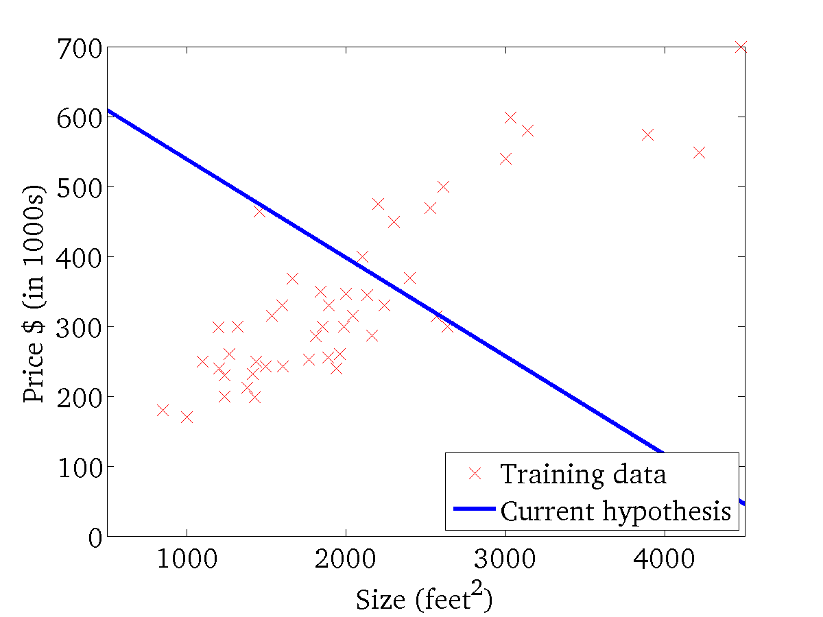
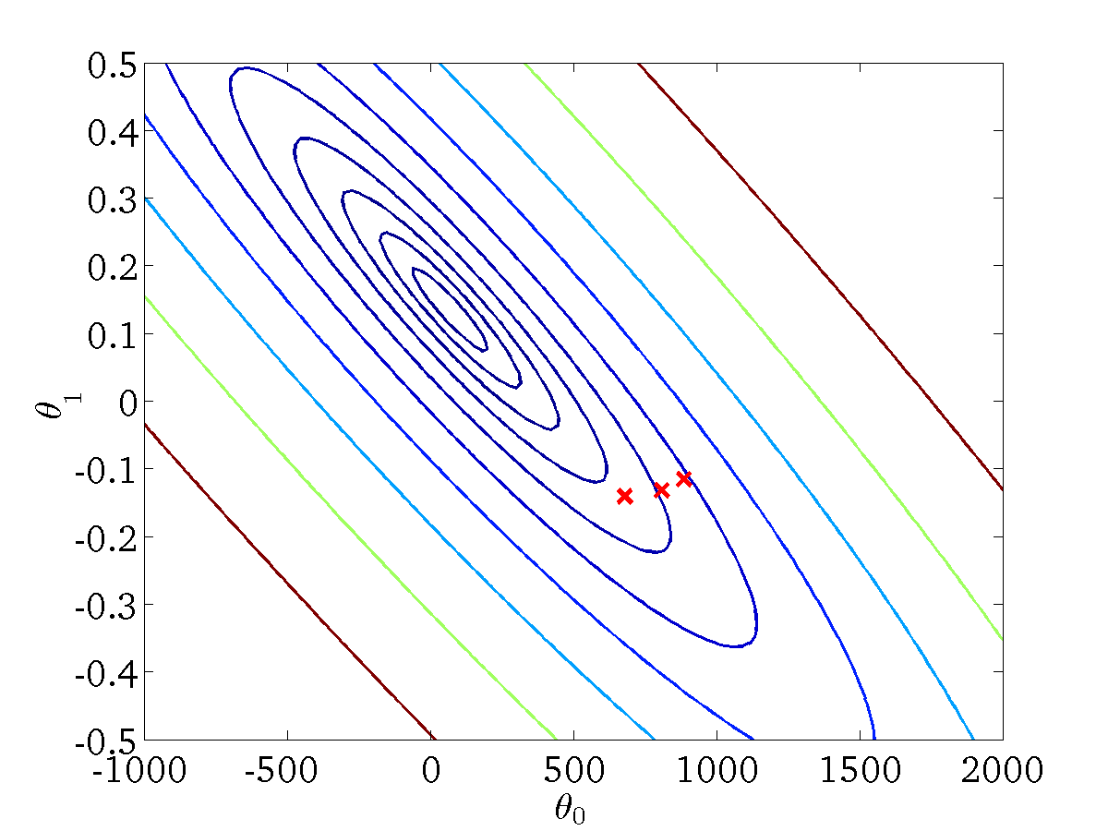
(for fixed , this is a function of x)
(function of the parameters )

Slide 37
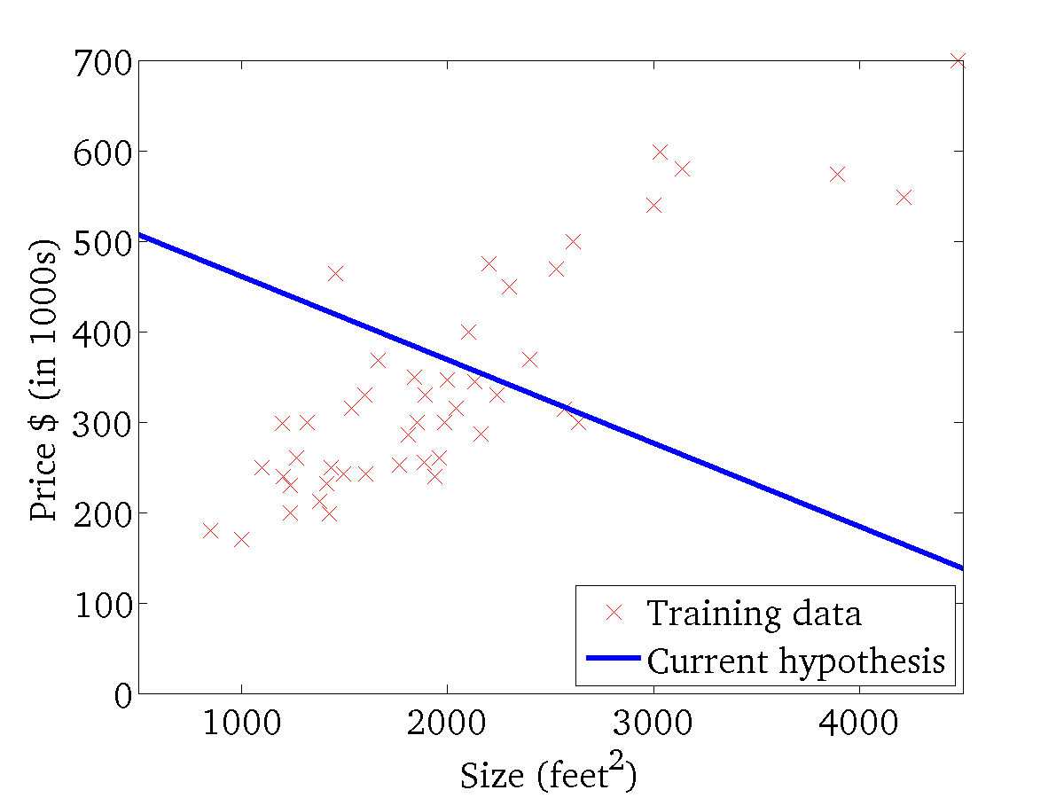

(for fixed , this is a function of x)
(function of the parameters )

Slide 38
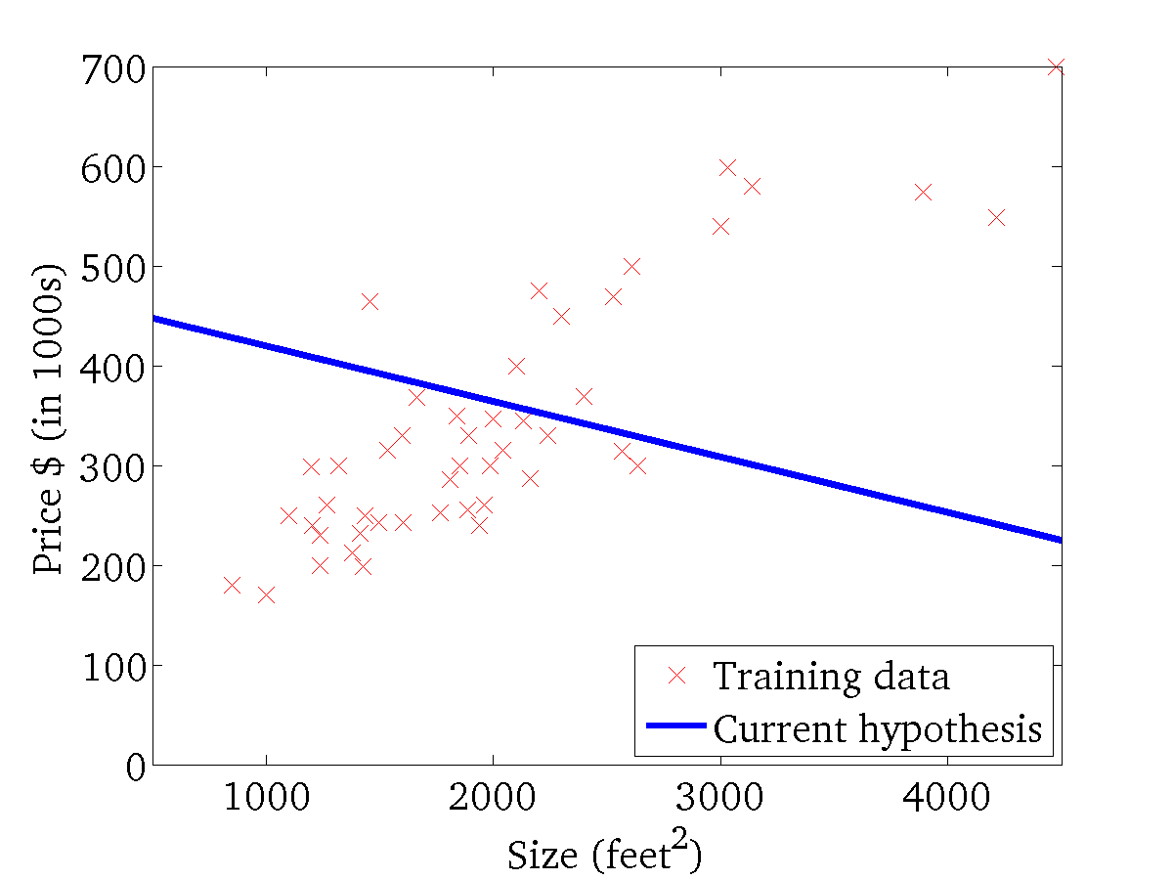
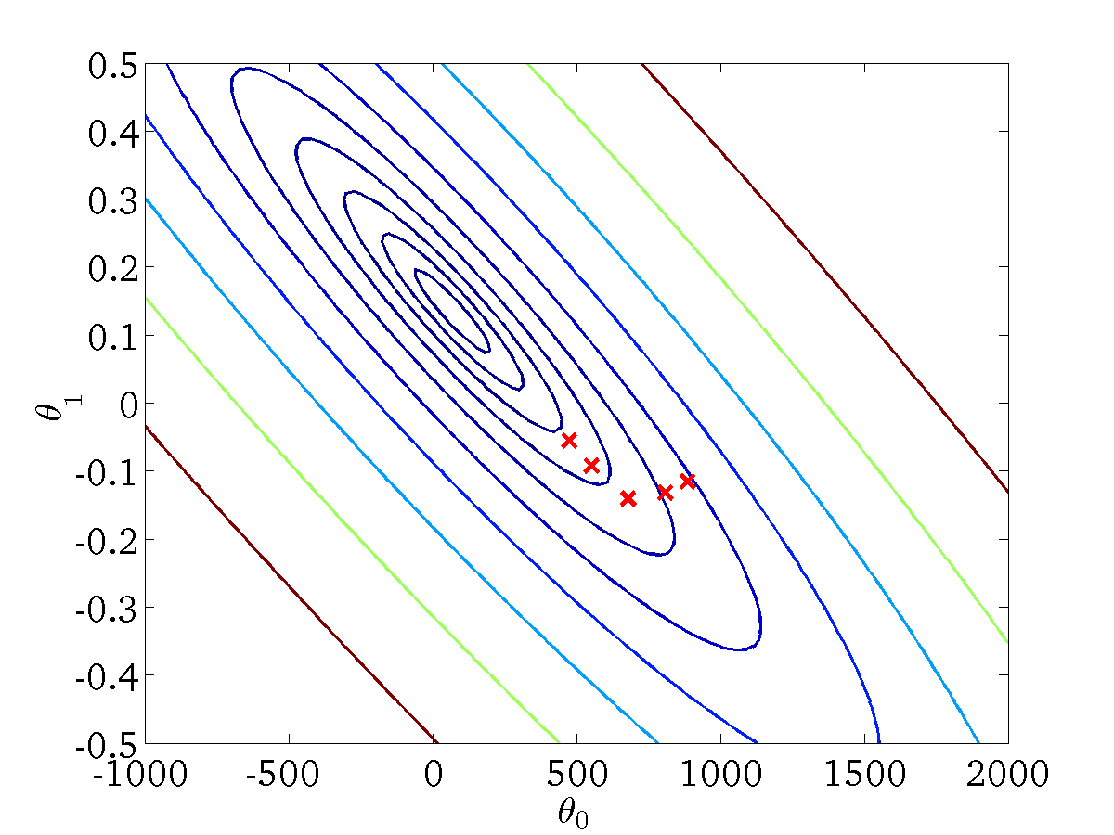
(for fixed , this is a function of x)
(function of the parameters )

Slide 39
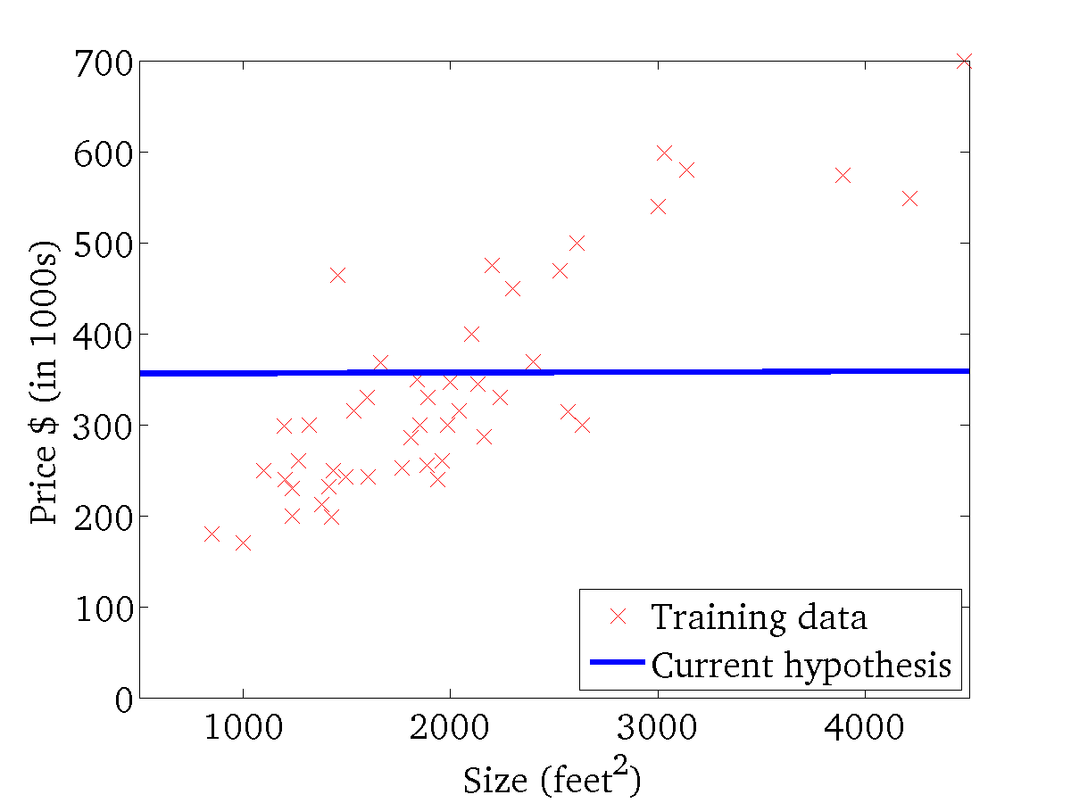

(for fixed , this is a function of x)
(function of the parameters )

Slide 40
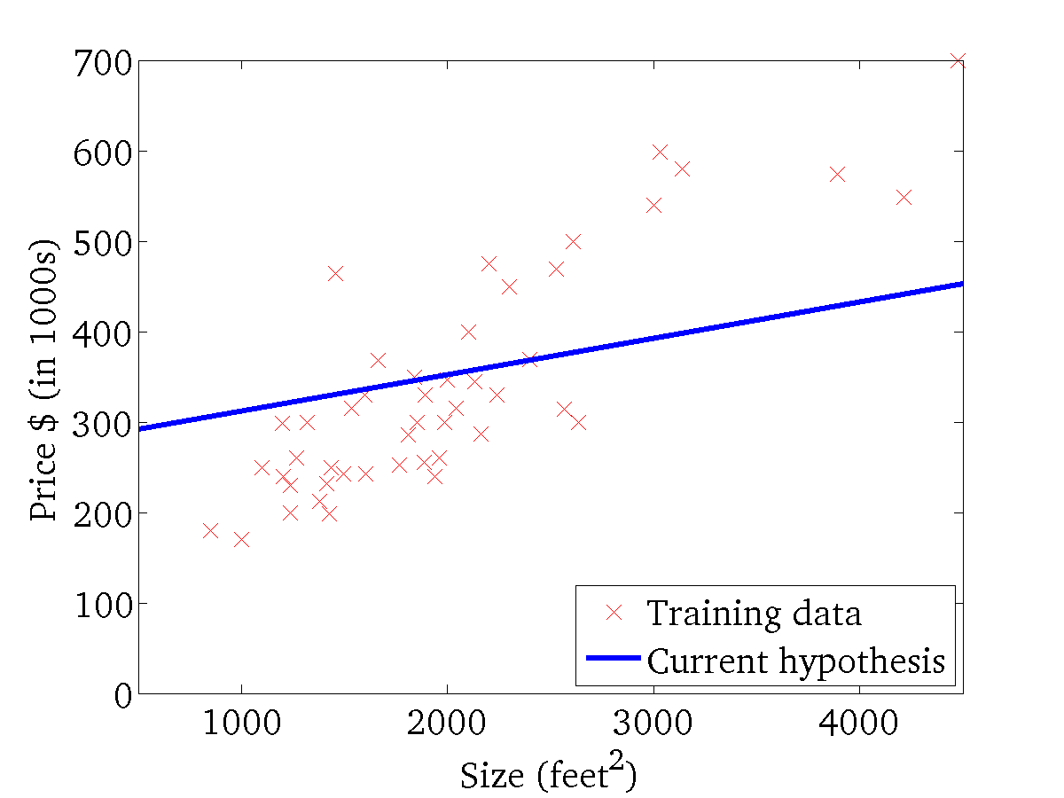

(for fixed , this is a function of x)
(function of the parameters )

Slide 41
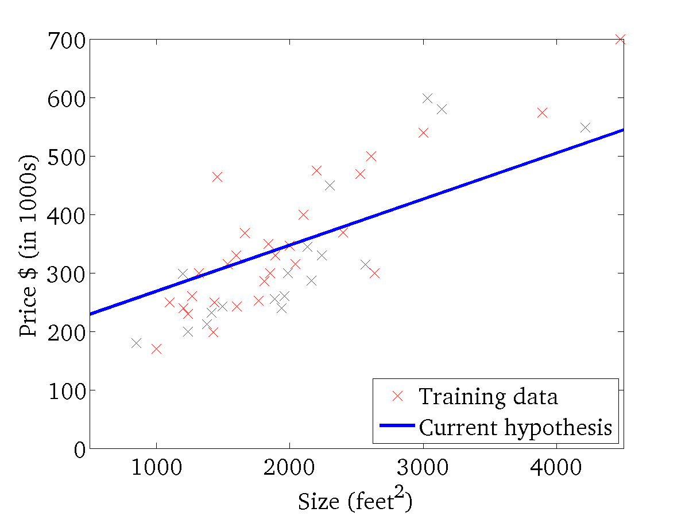
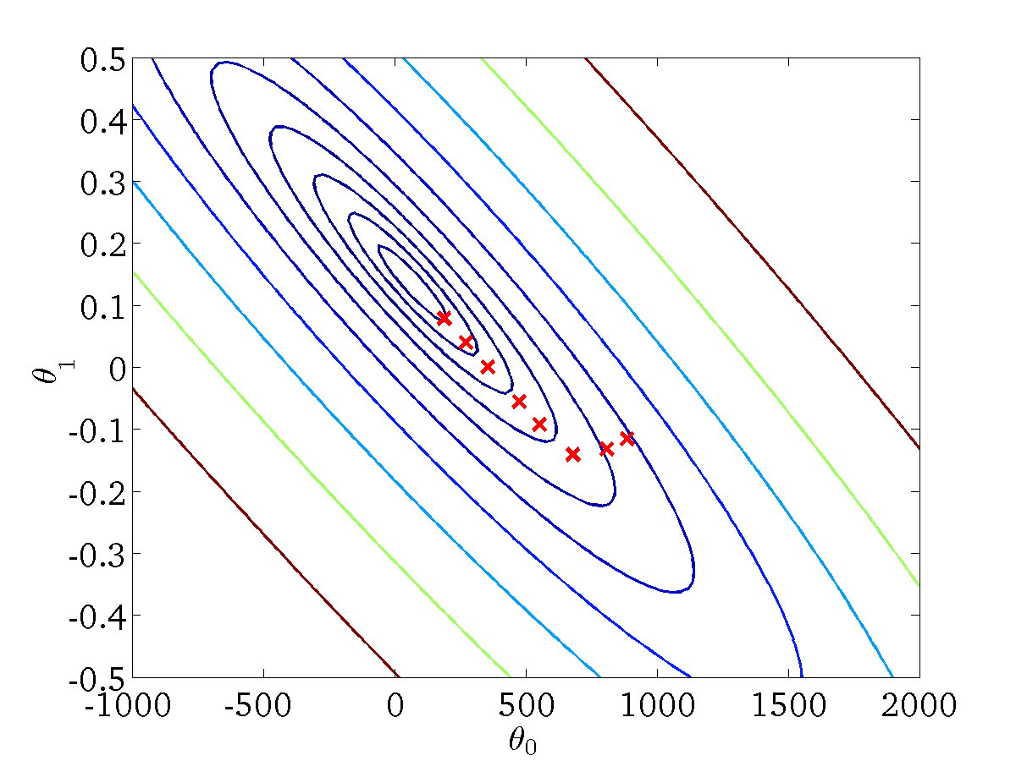
(for fixed , this is a function of x)
(function of the parameters )

Slide 42
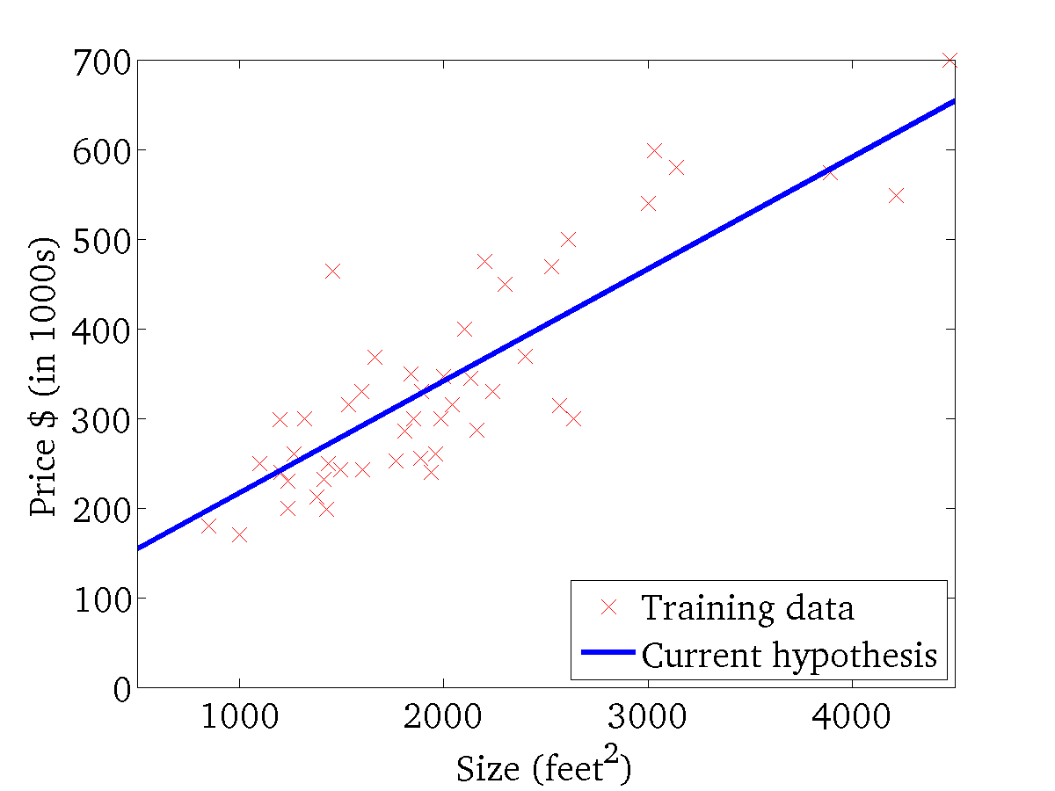

(for fixed , this is a function of x)
(function of the parameters )

Slide 43
“Batch” Gradient Descent
“Batch”: Each step of gradient descent uses all the training examples.

Slide 44
What’s Next

Slide 45
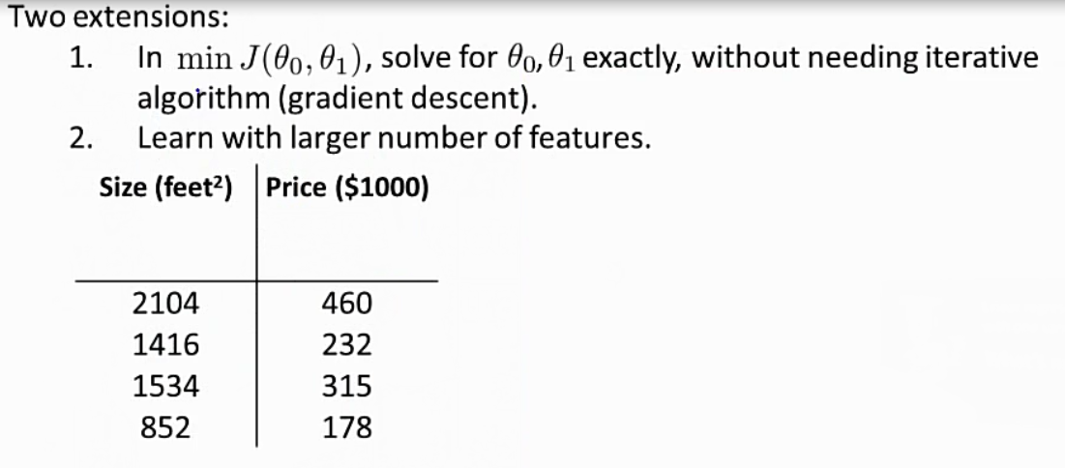

Slide 46
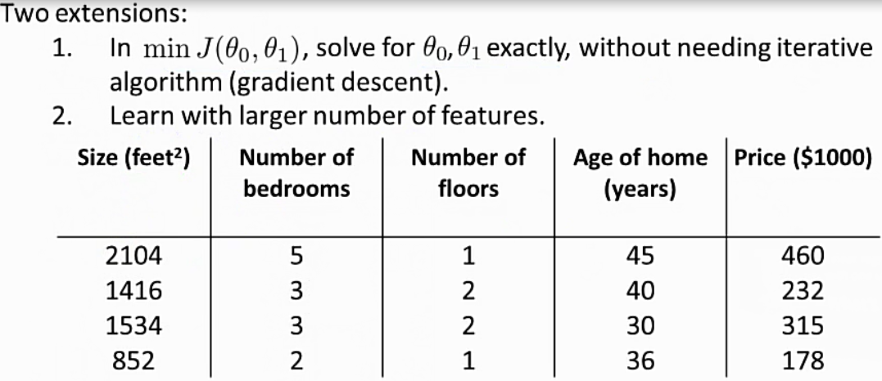

Slide 47
